Slide 1
Attacker Objectives
First we must understand, what they want to accomplish.

Slide 2

Different Objectives, for Different Adversaries
Nation-State
National secrets and IP.
Disruption and Distraction.
MDM (Disinfo).
Cybercrime
Ransomware and extortion.
Sale of stolen data.
Hacktivist
Data theft and Doxing.
DDoS.
Data destruction and sabotage.
Insider Threat
Revenge / grudge (see hacktivist).
Opportunist (see cybercrime)

Slide 3
Basics of Attack and Defense
The mechanics of a cyber attack can be relatively simple, at least when viewed at a high level to understand the general themes.

Slide 4

Two Types of Attacks (For Initial Foothold)
Attacks that involve a user.
Attacks that do not involve a user.
This Photo by Unknown Author is licensed under CC BY-SA-NC

Slide 5


Typical Attack Flow
Email or Messaging
User Interaction
Web
Social Engineering
Initial
Attack Vector Selected
Application
No User Interaction
Server, Services or Cloud Infr.
Account or Identity

Slide 6
It All Starts w/ OSINT / RECON
Email
OSINT to research people
User Interaction
Web
Persons of Interest
Social Engineering
Something Happens
Application
Systems of Interest
OSINT of Infrastructure
No User Interaction
Identity
Server and Infrastructure

Slide 7

Initial Flow: Involves User Interaction
A
Link
Phishing
Was the link clicked?
See Account and Identity Flow (X)
Yes
Note that links can have malware and malware and attachments can have phishing links.
Malware on a host can also compromise credentials.
Attachment
Malware
Did it execute?
See endpoint malware flow (Y)
Yes
Something Happens
Watering Hole
Malvertising, reflected XSS, etc.
Depending on the outcome of the flow may lead to account compromise or host compromise, which is where the user/no-user interaction paths begin to converge.
Insider Threat
A

Slide 8
Initial Flow Examples: Attack Not Involving a User
Note that many cases involving a compromised host via malware delivered to a user workstation, for example, ultimately lead to the same place as an attack not involving a user.
Exploitation Method:
Frameworks and Tools (basic):
Exploit Application
OWASP 10, WAF, and AppSec
Move Laterally
Compromise Account
ATT&CK, ZTA,
and IAM
Gain Privileged Account
Attacker Achieves Objectives
X
A
A
Exploit Running Service
ATT&CK, ZTA, and Host Hardening
Expand
Reach
Y
Exploit Host OS CVE
ATT&CK, Patching and EDR

Slide 9
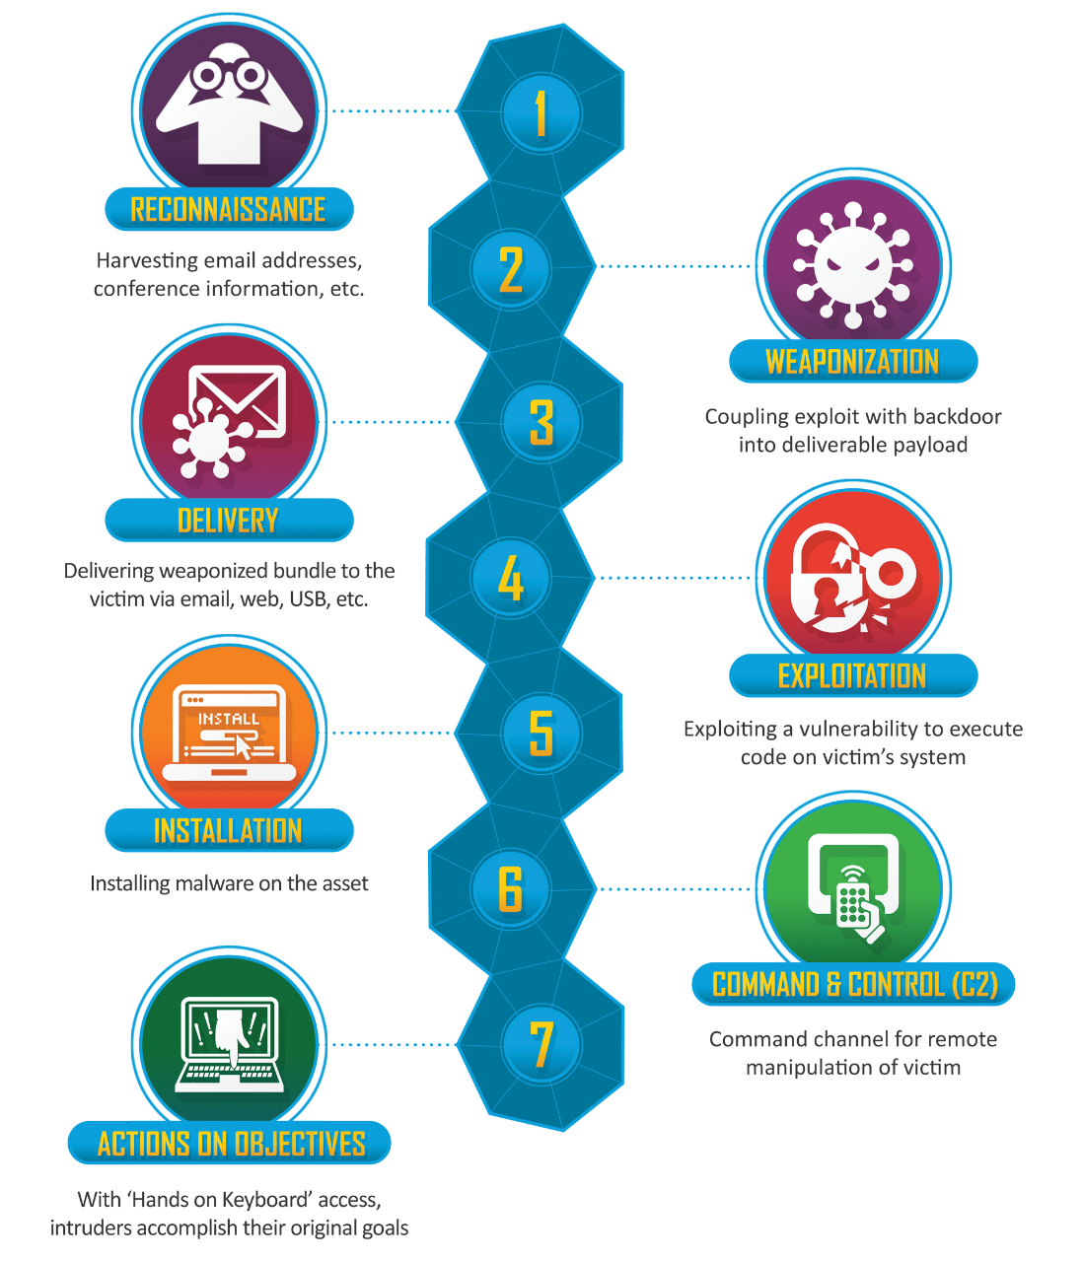
Cyber Kill Chain by Lockheed
https://www.lockheedmartin.com/en-us/capabilities/cyber/cyber-kill-chain.html

Slide 10
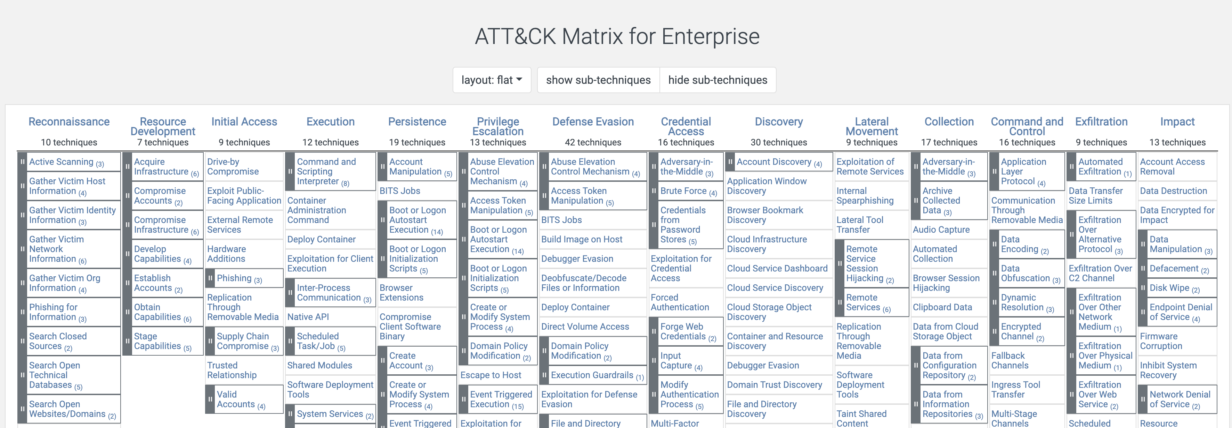
MITRE ATT&CK
https://attack.mitre.org/
How many places do you see an opportunity for malware, at various stages along this progression?

Slide 11

Learning Pro Tip: Make it Fun!
Reading Mitre ATT&CK may not be the most fun thing in the world.
Instead, learn via gameplay.
https://www.blackhillsinfosec.com/projects/backdoorsandbreaches/
Some free resources on the site, although the cards are quite fun.

